Slide 2

Visual Studio Code tips and tricks
Chris Dias
Principal Program Manager
VS Code
@chrisdias
74441,137​
BRK3066

Slide 3
Tips and tricks
Command Line
Theming
Navigation
Keybindings
Activity, Side Bars
Settings
Mastering the terminal
Code Editing
Debugging
Remote Development

Slide 4
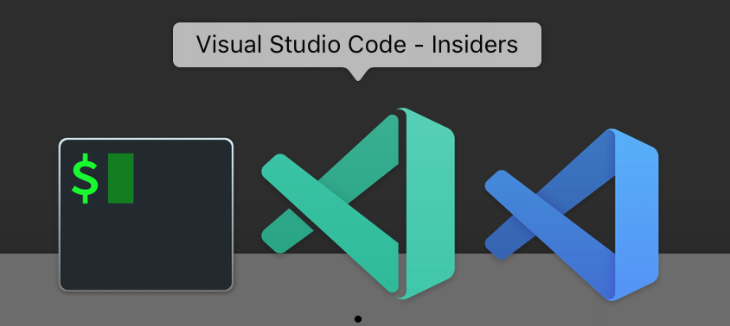
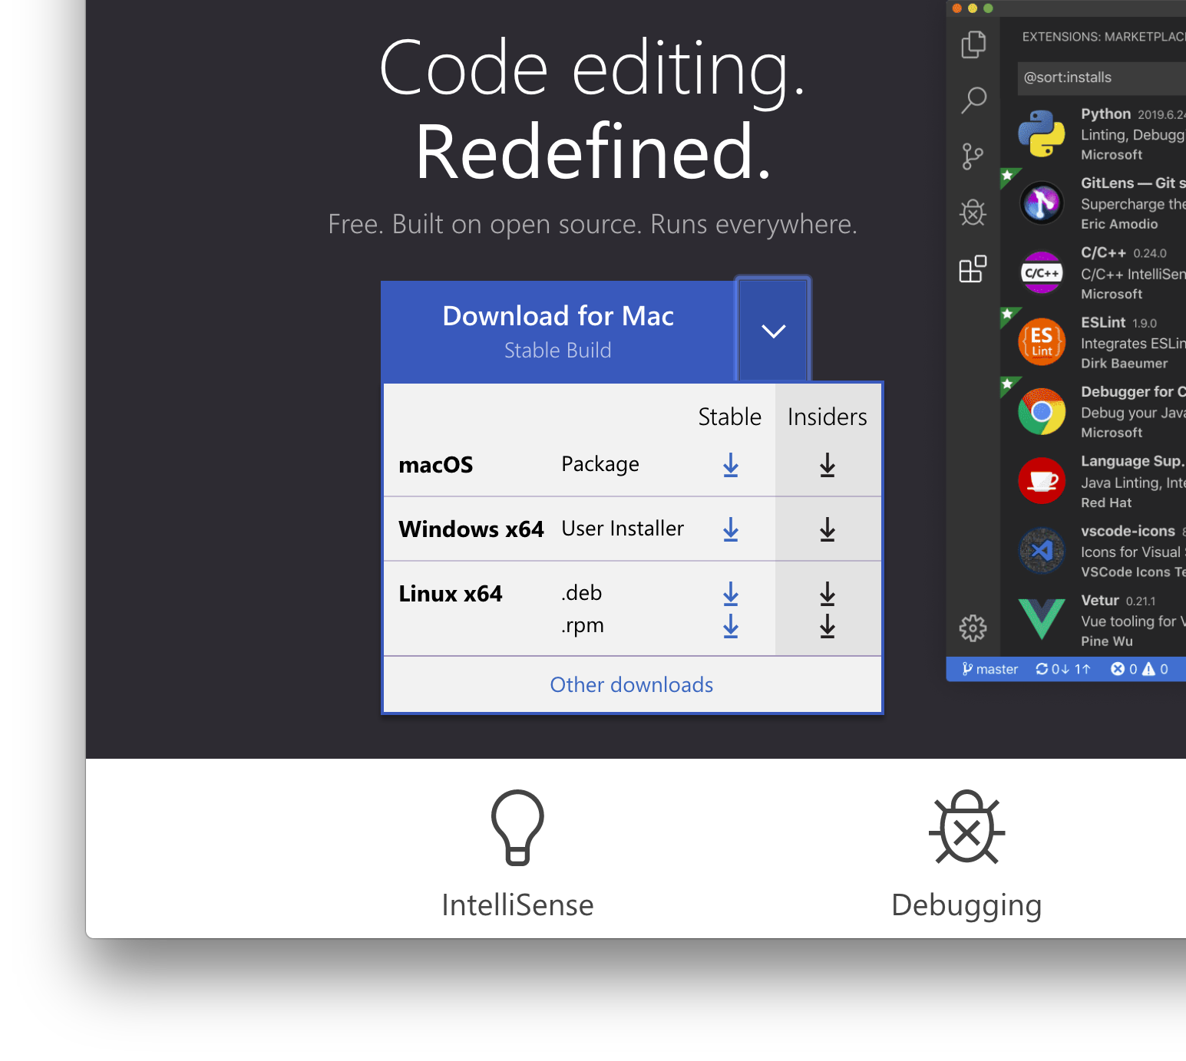
Insiders
The green icon
Ships every day
New features, bug fixes every day
Thank you for using it!

Slide 5
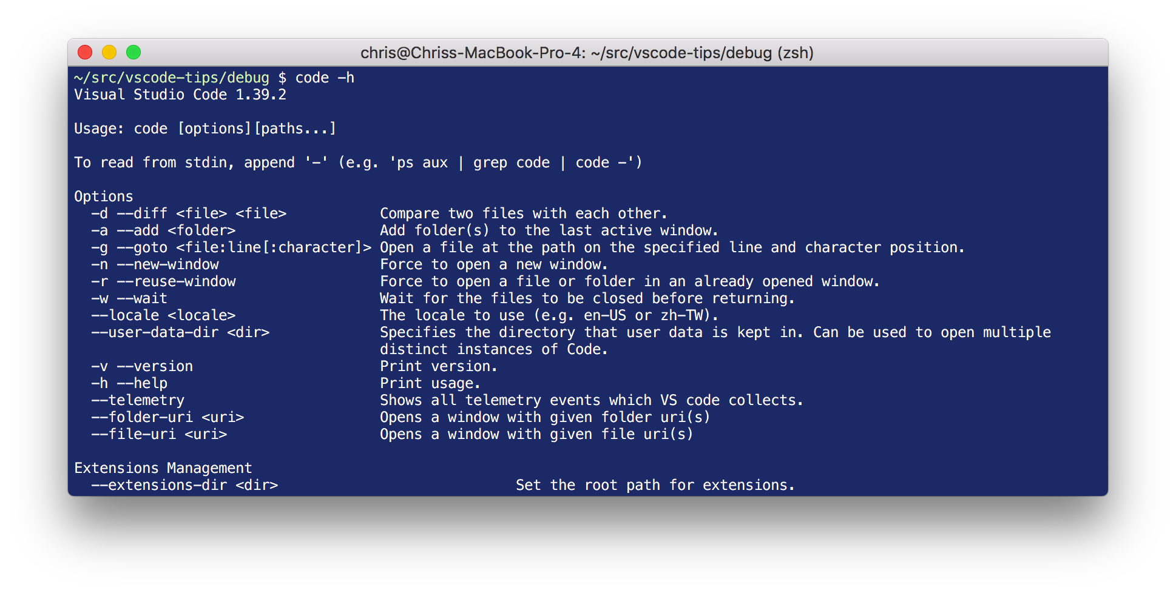
Command Line
code --help
F1 -> Shell Command: Install ‘code’ command in PATH

Slide 6

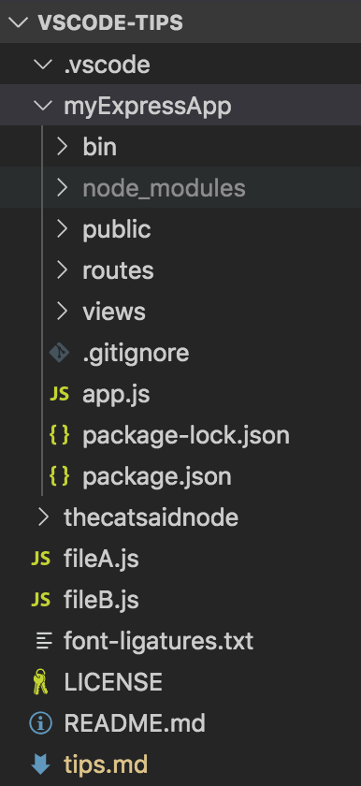
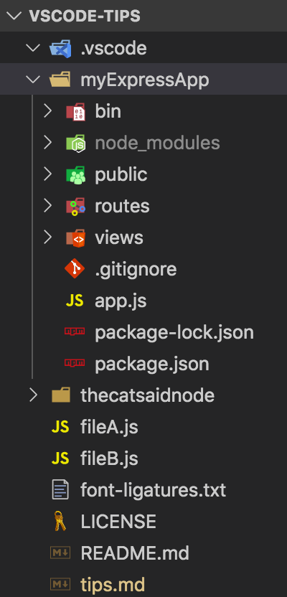
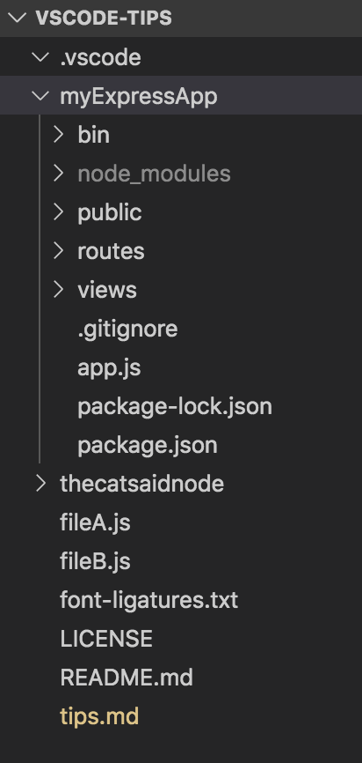
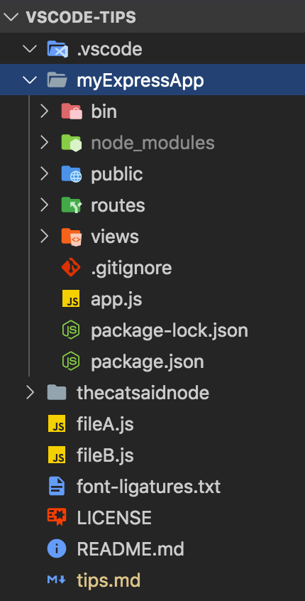
Themes
Color Themes
Preview, set right after installation
Can override general, theme colors
Disable built-in themes (and more)
Create you own Themes
File Icon Themes
Seti installed by default
Show/Hide icons on file tabs
"workbench.editor.showIcons"

Slide 7
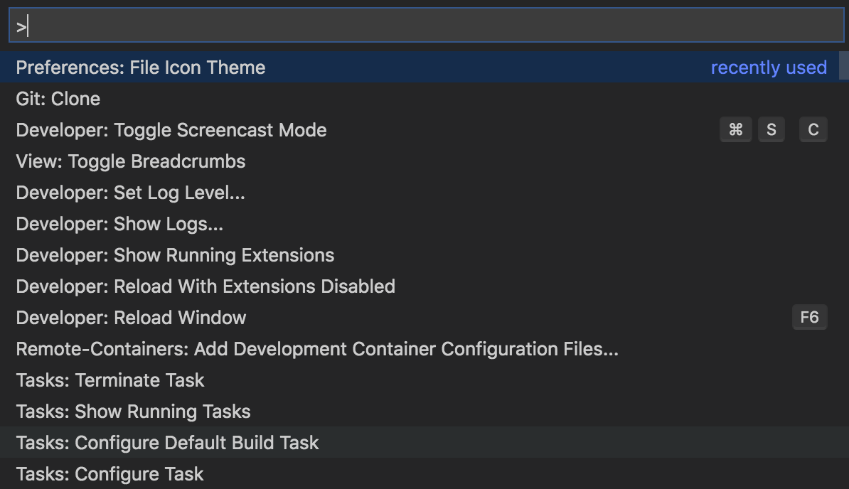
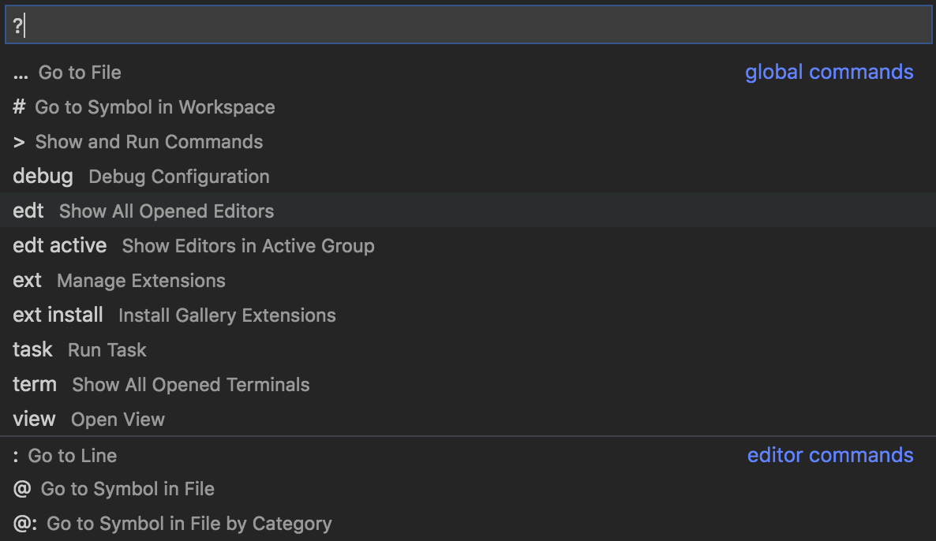
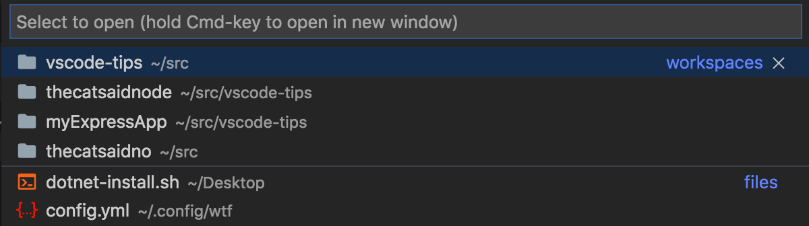
Navigation
Command Palette (CMD+SHIFT+P)
Breadcrumbs (CMD+SHIFT+;)
Recent (CTRL+R)
Hide Sidebar (CMD+B)
Editor Groups (CMD+number)
Editors (CTRL+number)
Zen Mode (CMD+K, then Z)
Viewlets
Debug (SHIFT+CMD+D)
Explorer (SHIFT+CMD+E)
Search (SHIFT+CMD+F)
Extensions (SHIFT+CMD+X)
Source Code Control (SHIFT+CTRL+G)

Slide 8
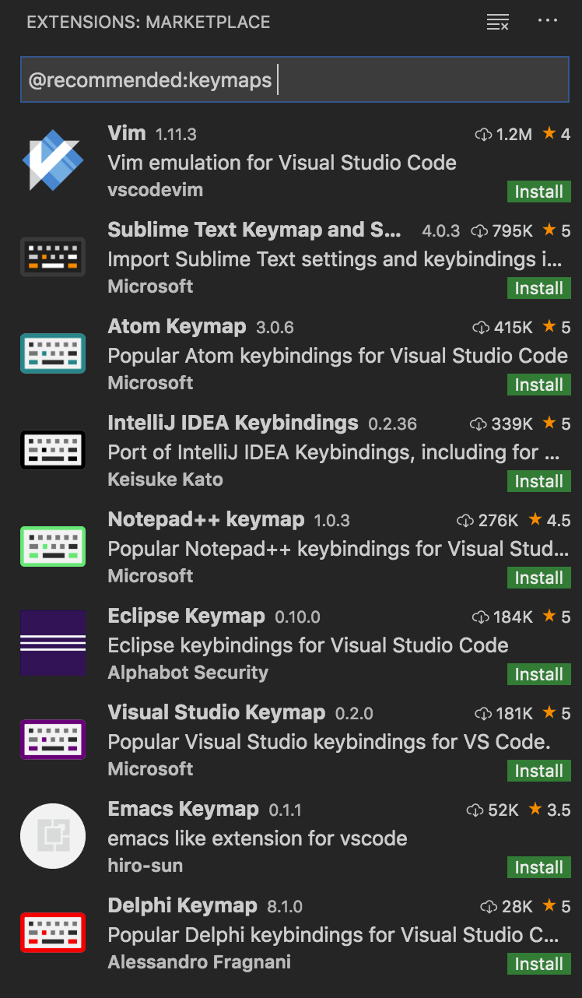
Key Bindings
“Record keys” to find bound actions, conflicts
Custom bindings to commands, tasks
When clause scopes a binding
Keymap Extensions

Slide 9
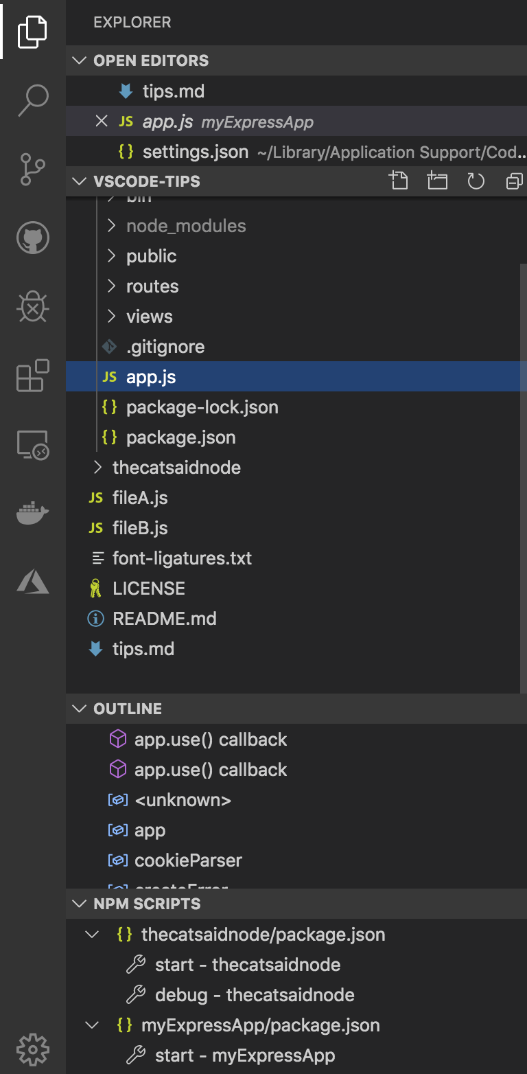
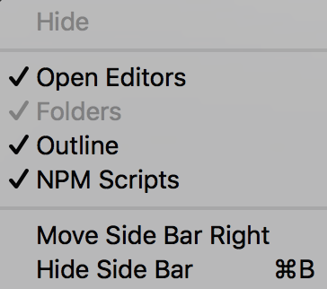
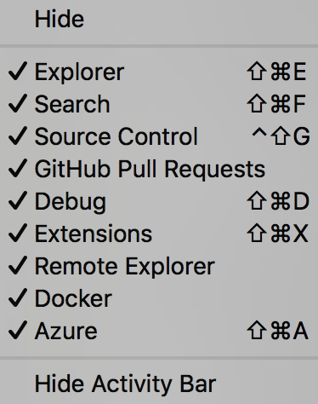
Side and Activity Bars
SideBar: Right Click to move left, right
Open Editors: Number visible files in settings.json
Explorers: Right click to show, hide
Add a file and a folder (e.g. foo/bar/index.html)
Compare files, Gutter diffs (when backed by SCC)
Search: Right click, toggle location
Activity Bar: Drag icons, right click to hide
Status Bar: Right click to hide extensions

Slide 10
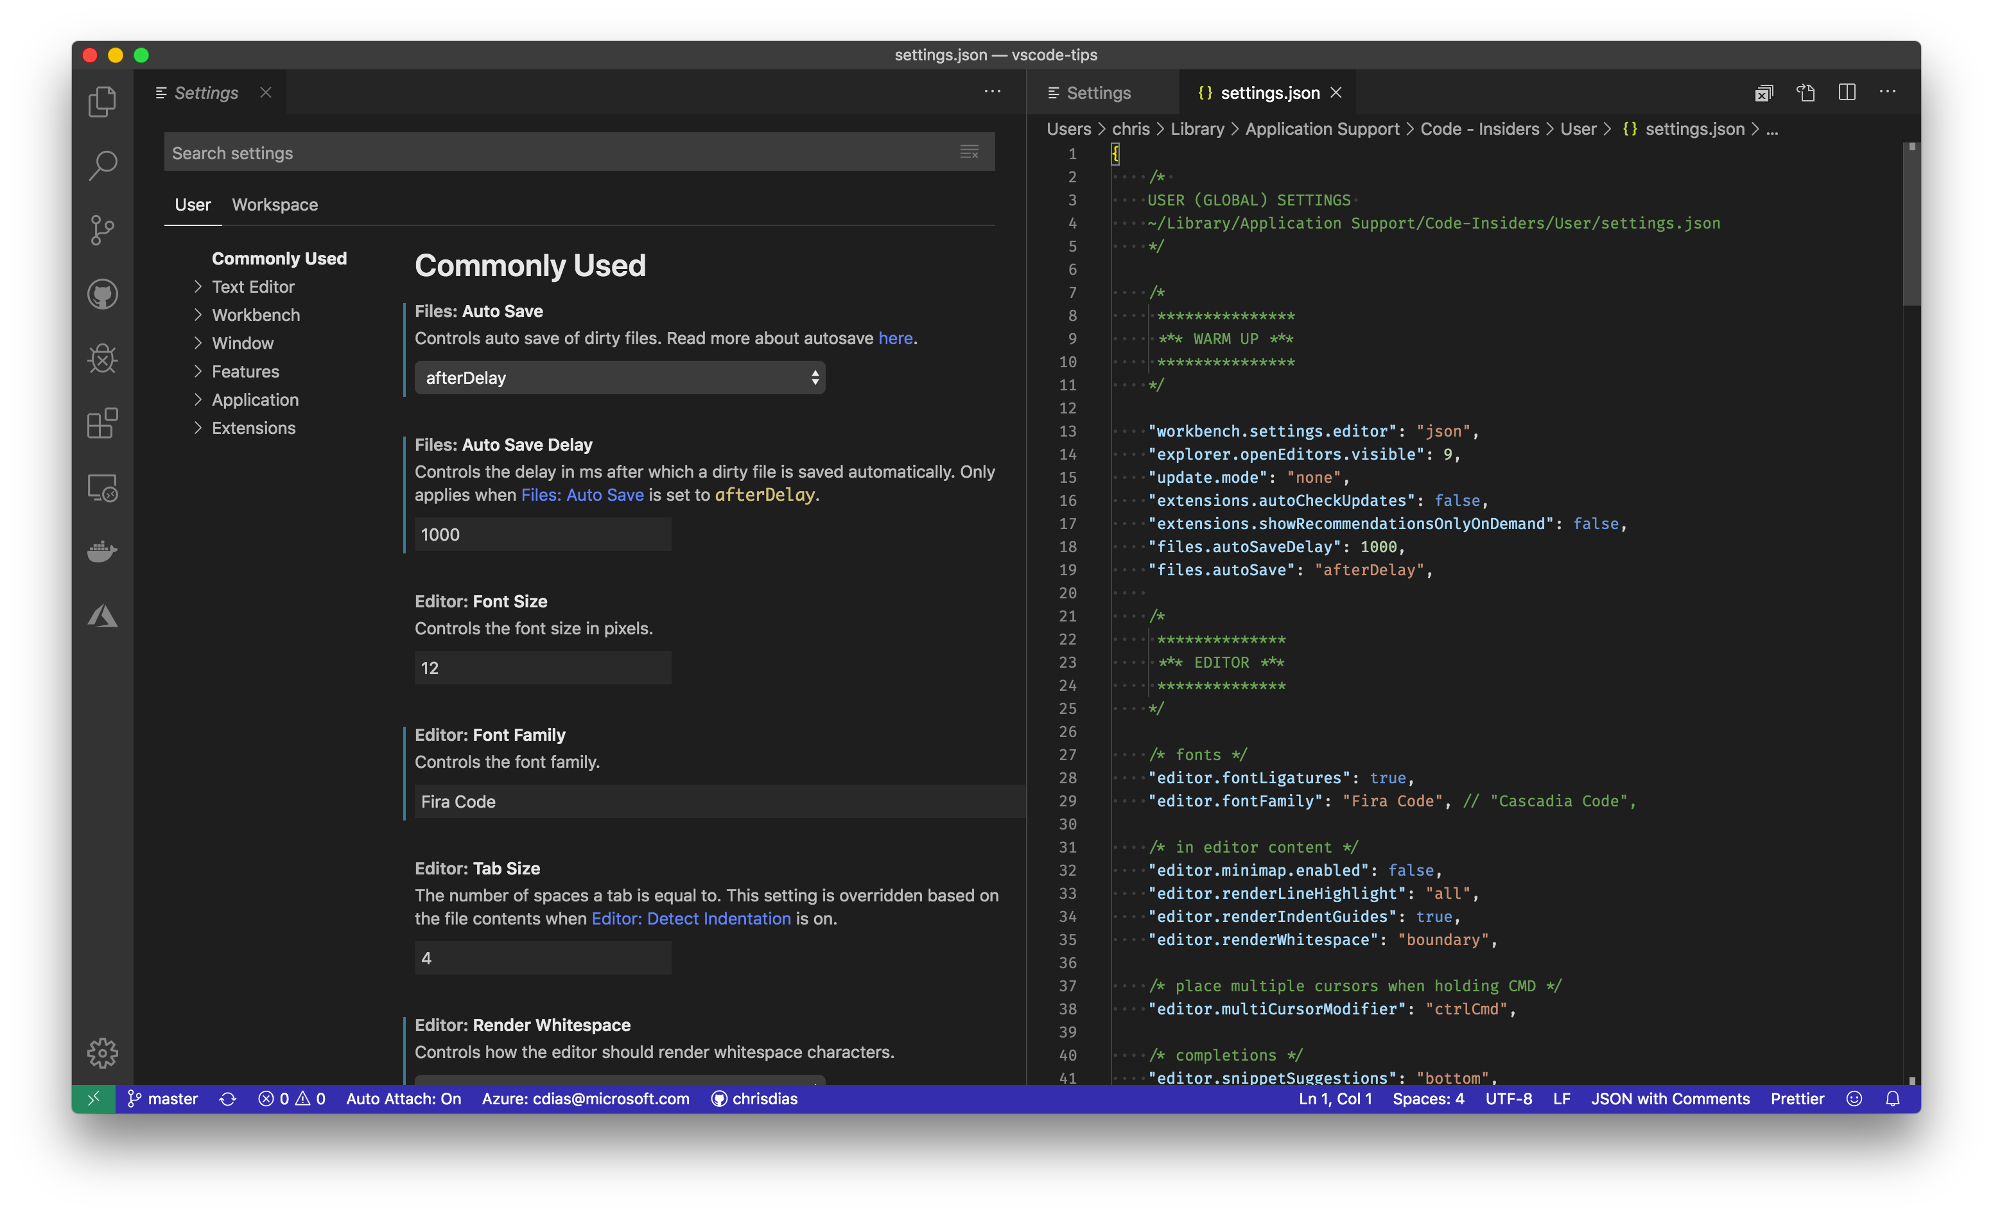
Settings
UI and JSON
Natural language search
Workspace, User, and Remote
My Settings

Slide 11
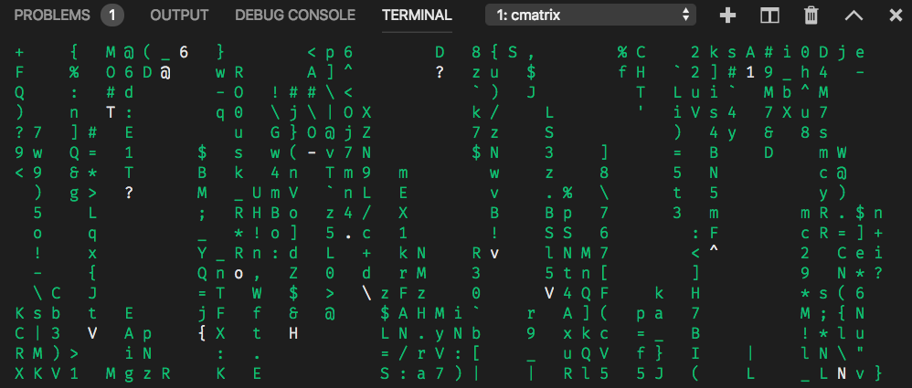
Mastering the Terminal
External: CMD+SHIFT+C
Defaults to workspace path
Internal: CTRL+`
Splitting, Renaming
Become a tmux master
Split Vertically: ctrl+b %
Show Panes: ctrl+b q
Move: ctrl+b > and ctrl+b <
Sessions: tmux ls and tmux a
Fun Settings
"terminal.integrated.showExitAlert": false
"terminal.integrated.shell.osx": "/bin/zsh”

Slide 12
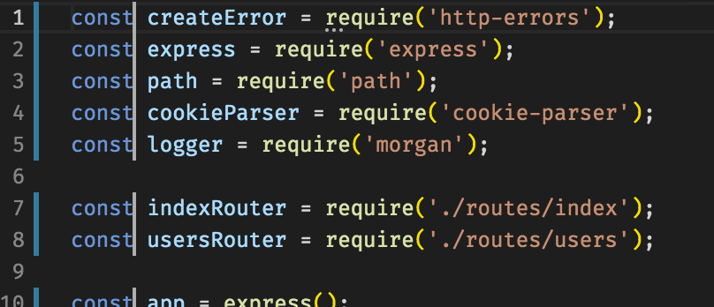
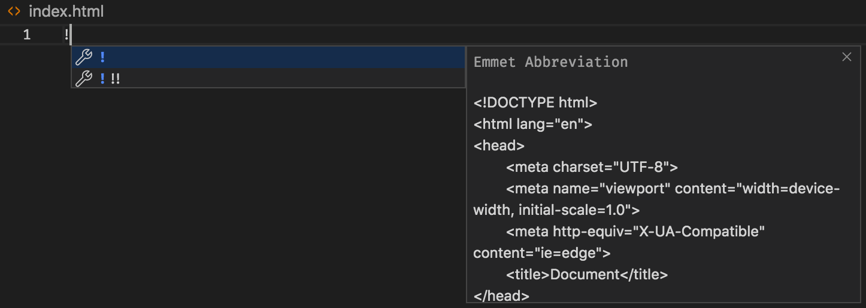
Code editing
Multiple Cursors
Add cursors: CMD+D
Add cursors on search results: CMD+SHIFT+L
Expand/Contract: CMD+Shift+Ctrl+Arrow
Emmet
! to scaffold HTML page
Down: div>ul>li*3>span.className
Up: Emmet: Wrap with Abbreviation

Slide 13
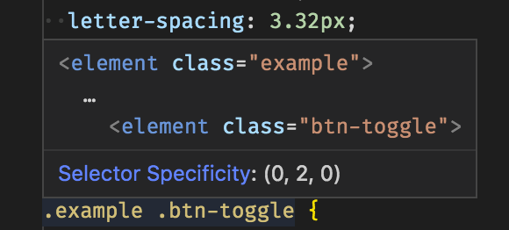
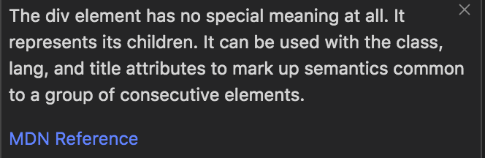
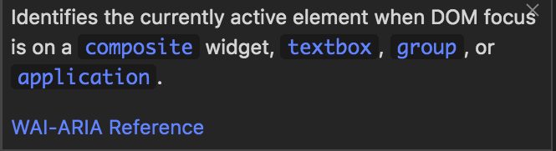
More code editing!
HTML and CSS editing
Getting CSS/SCSS preview by hovering over the selector
Mozilla Developer Network references
CSS help (Mozilla, accessibility)
ARIA help in aria- HTML tags
JavaScript
//@ts-check to type check plain Javascript
Extract to function, file

Slide 14
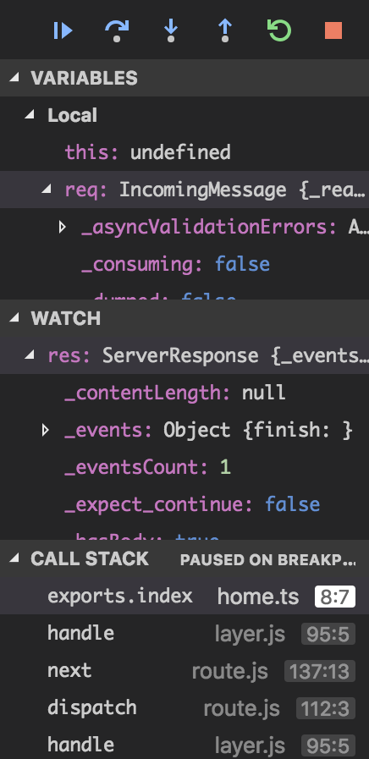
Debugging
Docked or floating toolbar
"debug.toolBarLocation": ”docked"
Configuration
No configuration needed for single files
launch.json
Compound debugging to debug multiple process
“Debug Receipes” bootstraps launch.json
Node.js goodies
Auto Attach (launch app with node --inspect)
Eliminate console.log with log points

Slide 15
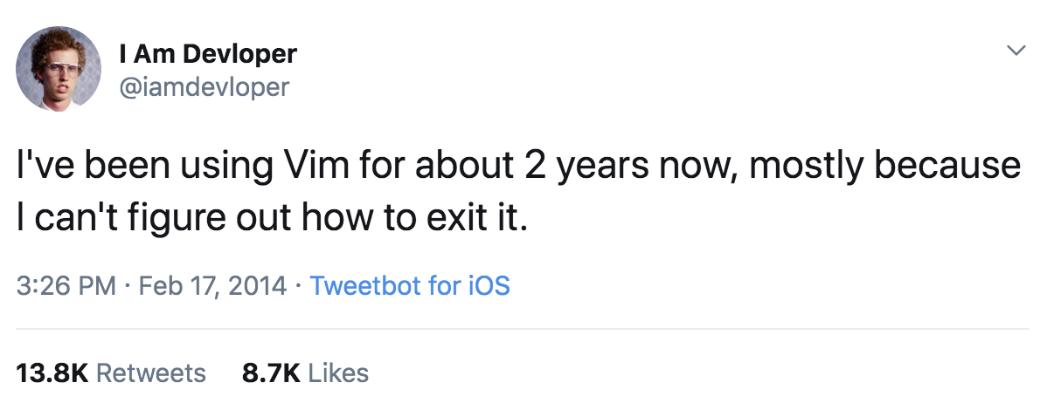
Remote Development
Pain: Setting up development environments
Dev, Test Increasingly Remote
Facebook: Mono repo, teams get giant VM as a remote dev box
Data Scientists: Leverage specialized VMs (e.g. GPU heavy servers)
Cloud Based Tools: codesandbox.io, coder.com, gitpod, stackblitz
Poor Development Experiences
VI or file syncing
Need to replicate context locally
Hard to set up remote desktop to Linux machines
Browser only tooling solutions

Slide 16
Remote Architecture
SSH
Docker Containers
Windows Subsystem For Linux (WSL)

Slide 17
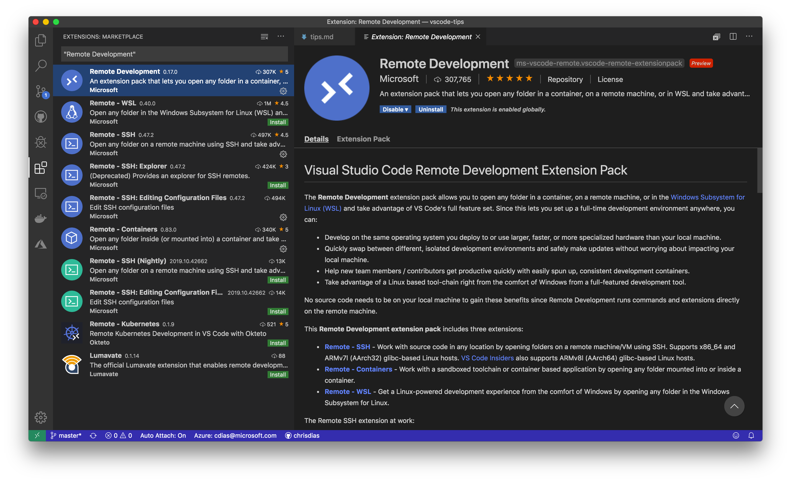
Remote Development
Solution: Client Tools Connected to Remote Services
Develop in the context of the remote machine or container
Remote Development Pack
Remote – SSH
Remote – WSL
Remote – Containers
New! Cloud Environments
Browser and Client tools

Slide 18
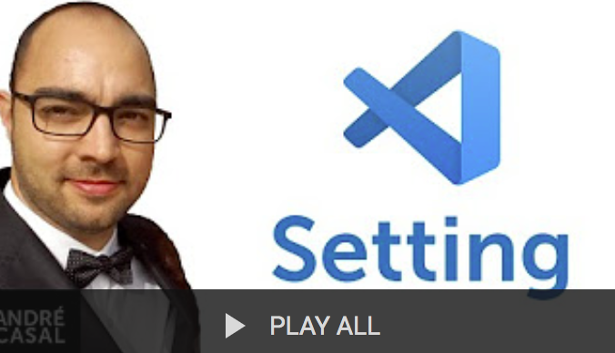
VS code settings video series
Andre Casal
492+ videos!
Thank you Andre!!

Slide 19
Additional useful links
More tips | https://code.visualstudio.com/tips
Debugging | https://github.com/microsoft/vscode-recipes
Remote | https://code.visualstudio.com/docs/remote
WSL | https://docs.microsoft.com/en-us/windows/wsl/about
Insiders | https://code.visualstudio.com/insiders/
Marketplace | https://marketplace.visualstudio.com/vscode
KeyBindings | https://code.visualstudio.com/shortcuts/keyboard-shortcuts-macos.pdf https://code.visualstudio.com/shortcuts/keyboard-shortcuts-windows.pdf https://code.visualstudio.com/shortcuts/keyboard-shortcuts-linux.pdf
My settings | https://gist.github.com/chrisdias/4fbc535ce1ab5387f6623e25df62de19
Repo | https://github.com/chrisdias/vscode-tips

Slide 20
More tips and tricks!

Slide 21
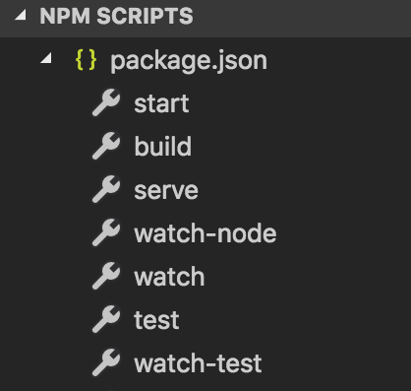
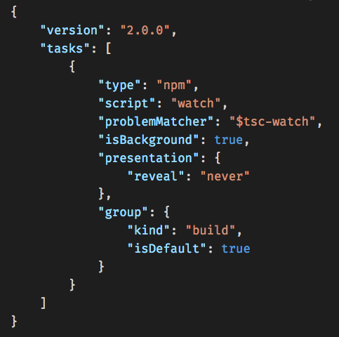
Automating jobs with tasks
Connect VS Code with your external tools
Automatically detects package.json
NPM SCRIPTS Explorer
Debugging
Add, override with .vscode/tasks.json
Automate with key bindings
"command": "workbench.action.tasks.runTask”

Slide 22
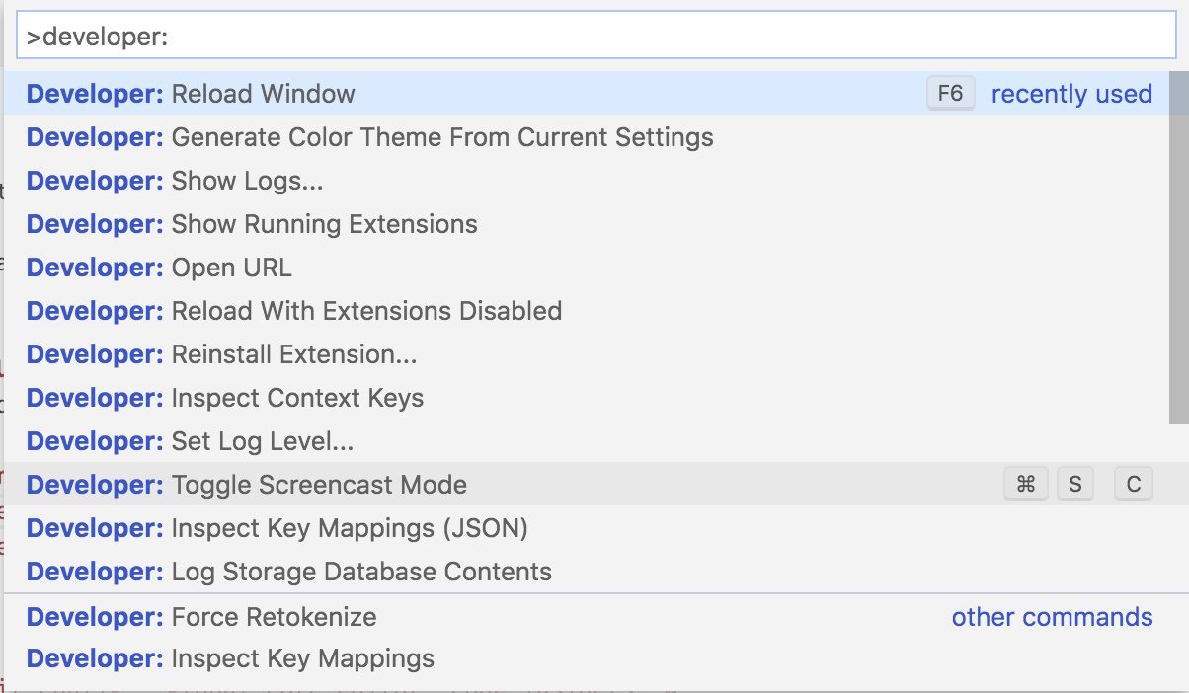
Developer tools
Reload Window
Toggle Dev Tools
Disable Extensions
KeyMapping
Performance Analysis
Logging

Slide 23
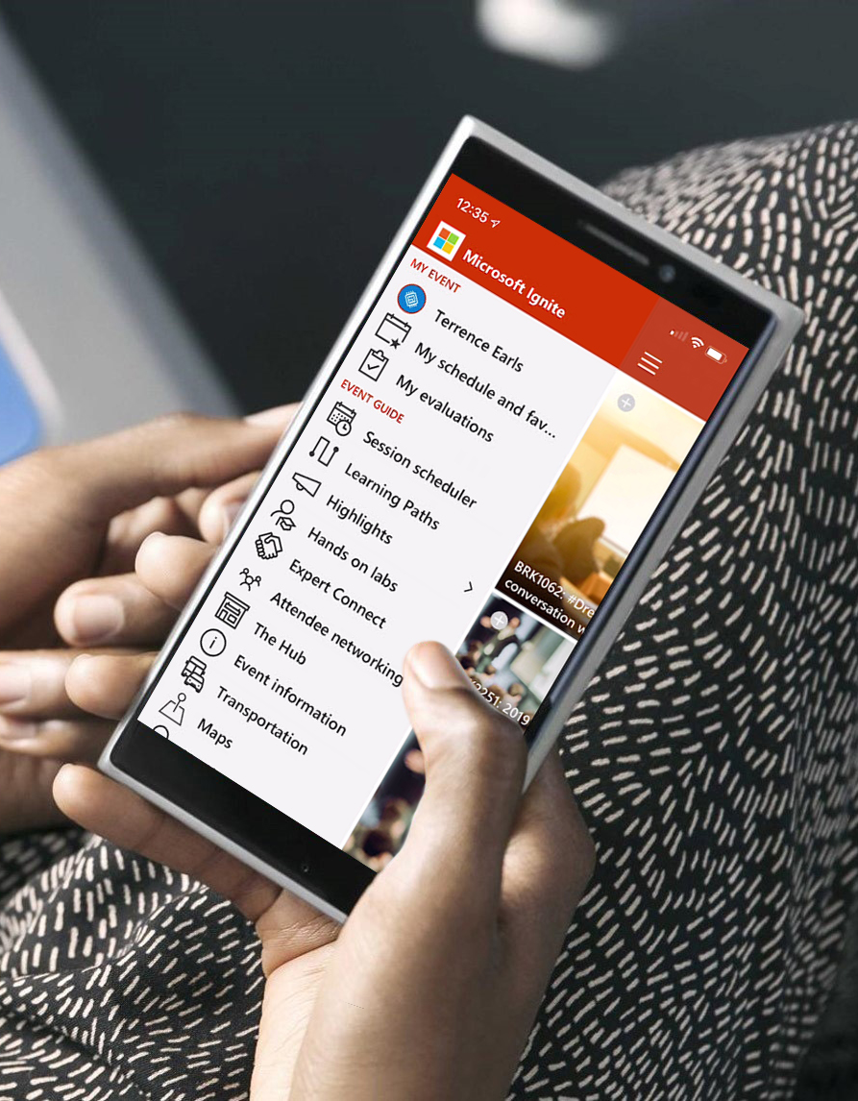
Please evaluate this session Your feedback is important to us!
Please evaluate this session through MyEvaluations on the mobile app or website.
Download the app: https://aka.ms/ignite.mobileapp
Go to the website: https://myignite.techcommunity.microsoft.com/evaluations

Slide 24
Visit aka.ms/MicrosoftIgnite2019/BRK3066
Download slides and resources
Access session recordings in 48 hours
Ask questions & continue the conversation
Find this session in Microsoft Tech Community

